Slide 1

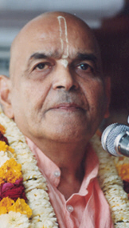
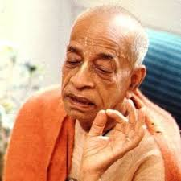
जीने की कला Art of Living
Based on Bhagavat Saptah Lecture by HH Maha Vishnu Goswami Maharaj in Sydney

Slide 2
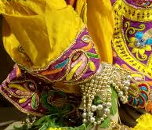
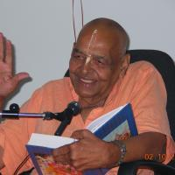
Recap
Duty in this age
Lead simple life
Don’t waste time in mental concoction
Utilize time in serious study of Bhagavatam
Medicine for this age
Hear, Study and Contemplate
Heart is meant for Krishna
Solution to our dissatisfaction
Spirit cannot be happy with matter.
Glorify Lord Sri Krishna
What is Real Wealth
Pleasing Krishna pleases everyone
Laxmi or Durga
Remembrance of Krishna

Slide 3
Recap
How to handle distress
Humbly Tolerance and have Patience
Improved karma leads to happiness
No one knows plan of the invisible actor

Slide 4
पुनरावृत्ति
इस युग में कर्तव्य
सादा जीवन जिए
मानसिक मनगढ़ंत में समय बर्बाद न करें
भागवतम् के गंभीर अध्ययन करें
इस युग के लिए दवा
तच्छृण्वन् सुपठन् विचारणपरो [SB 12.13.18]
हृदय कृष्ण के लिए है
हमारे असंतोष का समाधान
आत्मा पदार्थ से खुश नहीं हो सकती
भगवान कृष्ण की महिमा करें
वास्तविक धन क्या है
यास्मीन तुष्टे जगत् तुष्टे
लक्ष्मी या दुर्गा
कृष्ण का स्मरण

Slide 5
पुनरावृत्ति
संकट से कैसे निपटें ?
विनम्रता, धीरज, सभी का सम्मान
अच्छे कर्म से खुशी मिलती है
अदृश्य अभिनेता की योजना कोई नहीं जानता

Slide 6
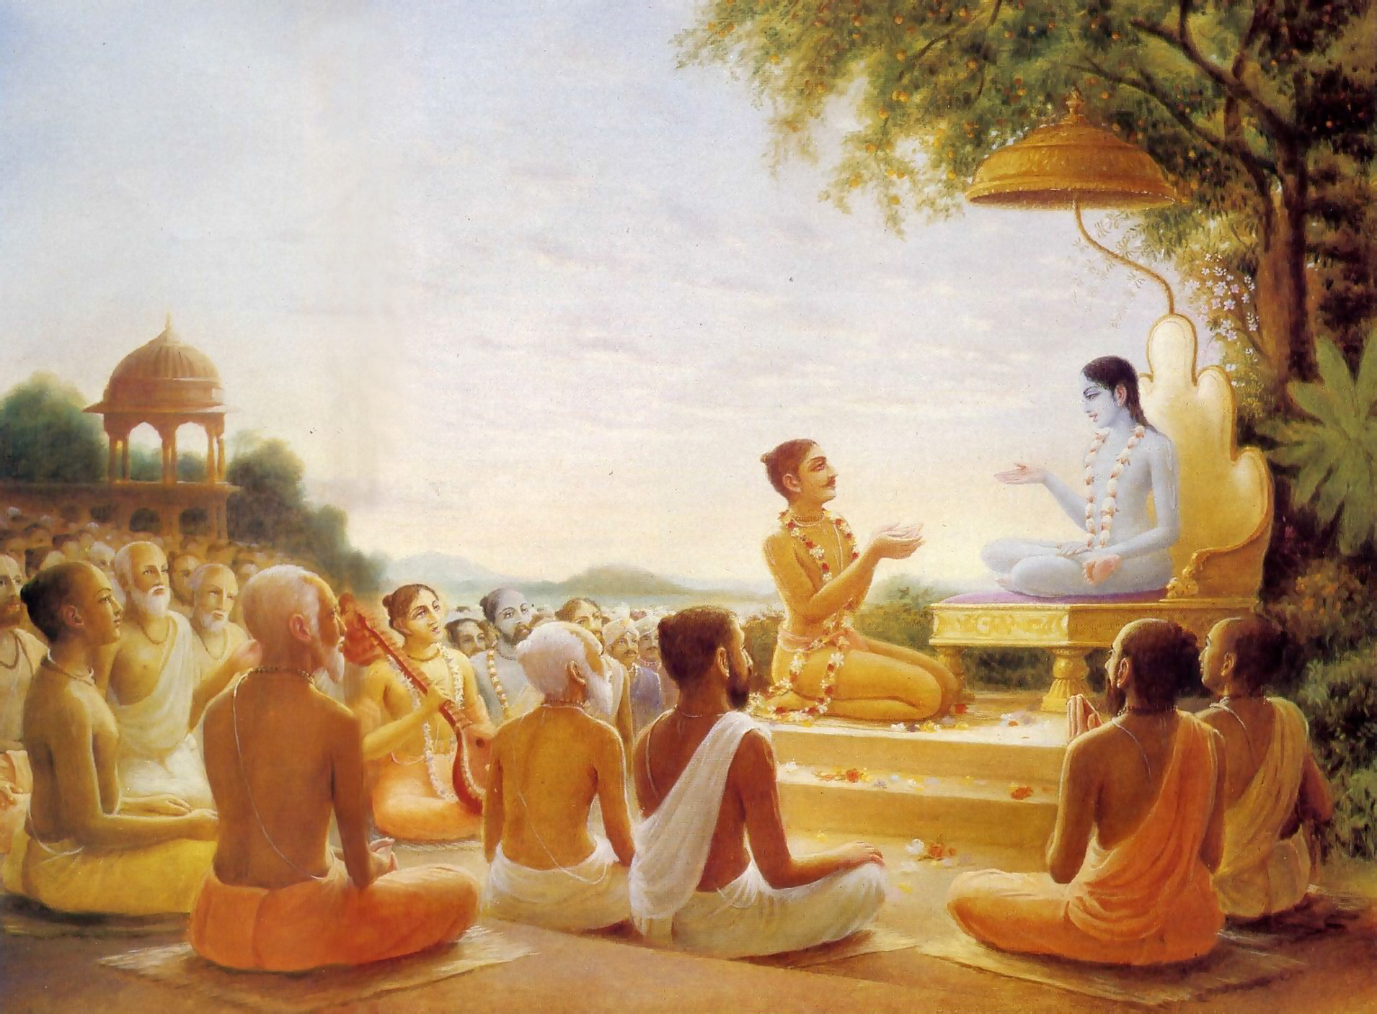
We have to go!
पुनश्च भूयाद्भगवत्यनन्ते
रति: प्रसङ्गश्च तदाश्रयेषु । महत्सु यां यामुपयामि सृष्टिं
मैत्र्यस्तु सर्वत्र नमो द्विजेभ्य: ॥ १६ ॥
punaś ca bhūyād bhagavaty anante
ratiḥ prasaṅgaś ca tad-āśrayeṣu mahatsu yāṁ yām upayāmi sṛṣṭiṁ
maitry astu sarvatra namo dvijebhyaḥ
Again, offering obeisances unto all you brāhmaṇas, I pray that if I should again take my birth in the material world I will have complete attachment to the unlimited Lord Kṛṣṇa, association with His devotees and friendly relations with all living beings. [SB 1.19.16]

Slide 7
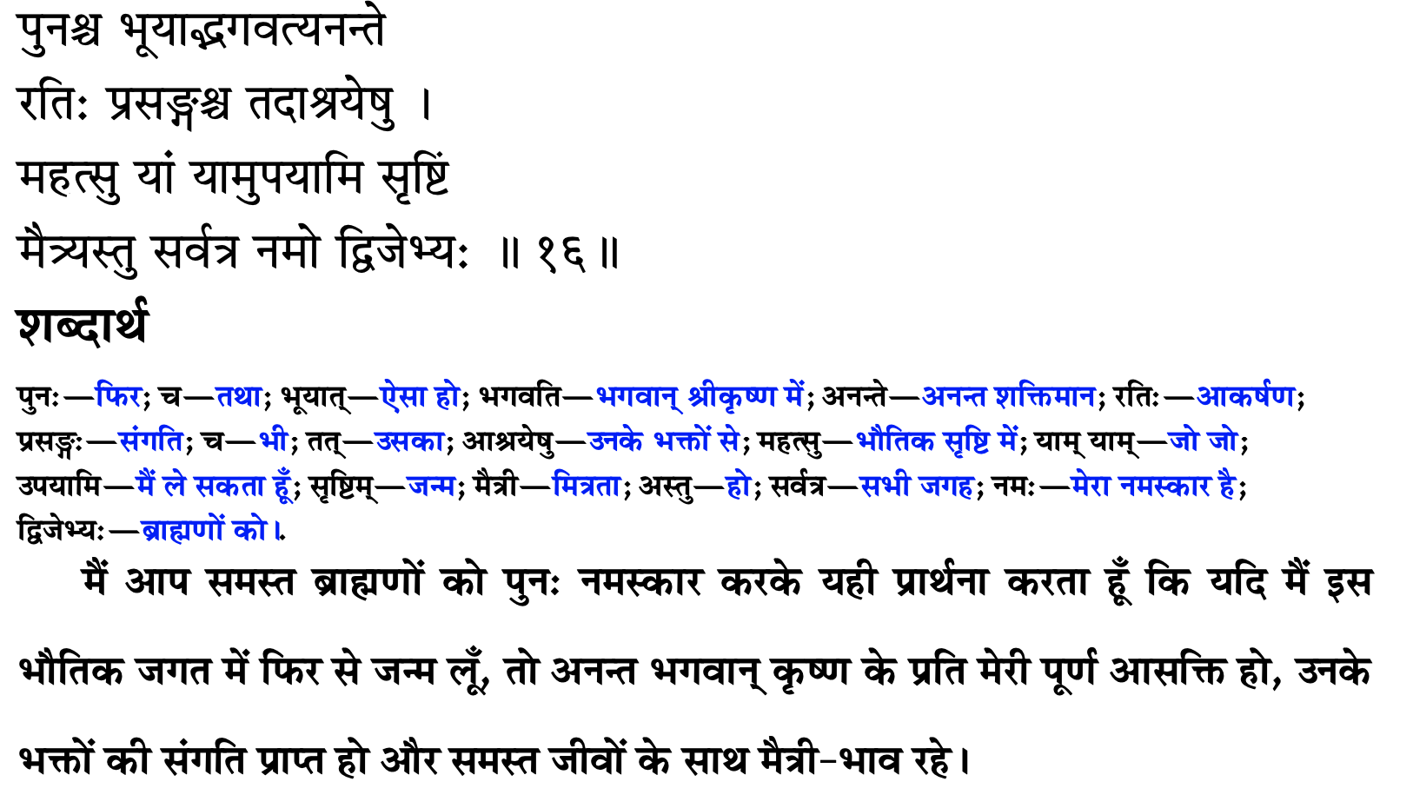
हमने जाना है

Slide 8
Art of Living
May I be always attracted towards Lord Sri Krishna.
May I have attraction towards those who are surrendered to Kåñëa. May I have association of devotees of Lord Sri Krishna.
May I have friendly and equal relations with everybody.
You can have very workable relationships with everybody.
No intimacy!
dadämi buddhi yogam tam. God gives you intelligence from within
By creating amicable relationship with everybody, whatever time is saved, should be invested in the pages of Bhägavatam.

Slide 9
जीने की कला
मैं हमेशा कृष्ण की ओर आकर्षित रहूं
मुझे कृष्ण भक्तों की संगति, रति: हो
मेरा सभी के साथ दोस्ताना और समान संबंध हो
हर किसी के साथ उत्तम रिश्ते हो
कोई आत्मीयता नहीं!
दादामि बुद्धी योगम् तम्। परमात्मा आपको अंदर से बुद्धि देता है
हर किसी के साथ सौहार्दपूर्ण संबंध बनाकर, जो भी समय बचता है, उसे भागवतम के पन्नों में निवेश करना चाहिए।

Slide 10
Attached to a Lord’s devotee
That a devotee of the Lord is the only perfect living being is explained herein by Mahārāja Parīkṣit.
A devotee of the Lord is no one’s enemy, although there may be many enemies of a devotee.
A devotee of the Lord does not like to associate with nondevotees, although he has no enmity with them.
He desires association with the devotees of the Lord. This is perfectly natural because birds of the same feather mix together.
And the most important function of a devotee is to have complete attachment for Lord Śrī Kṛṣṇa, the father of all living beings.
As a good son of the father behaves in a friendly way with all his other brothers, so also the devotee of the Lord, being a good son of the supreme father, Lord Kṛṣṇa, sees all other living beings in relation with the supreme father.
He tries to bring back the upstart sons of the father to a saner stage and to get them to accept the supreme fatherhood of God.
Mahārāja Parīkṣit was certainly going back to Godhead, but even if he were not to go back, he prayed for a pattern of life which is the most perfect way in the material world.
A pure devotee does not desire the company of a personality as great as Brahmā, but he prefers the association of a petty living being, provided he is a devotee of the Lord.

Slide 11
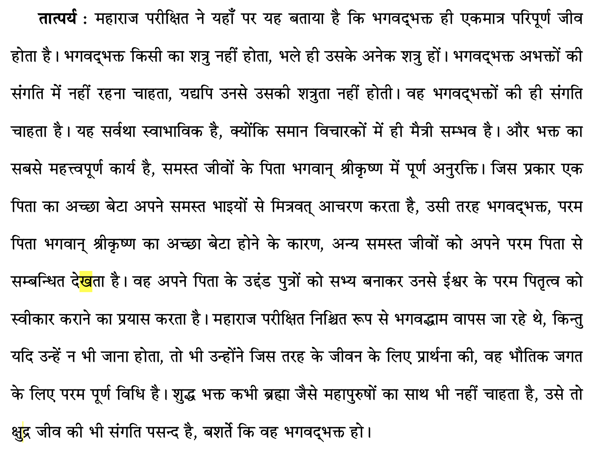

Slide 12
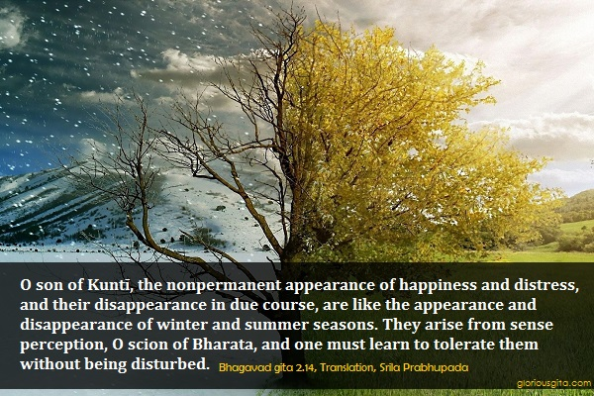

Slide 13
Tolerance
मात्रास्पर्शास्तु कौन्तेय शीतोष्णसुखदुःखदाः । आगमापायिनोऽनित्यास्तांस्तितिक्षस्व भारत ॥ १४ ॥
mātrā-sparśās tu kaunteya śītoṣṇa-sukha-duḥkha-dāḥ āgamāpāyino ’nityās tāṁs titikṣasva bhārata
mātrā-sparśāḥ — sensory perception; tu — only; kaunteya — O son of Kuntī; śīta — winter; uṣṇa — summer; sukha — happiness; duḥkha — and pain; dāḥ — giving; āgama — appearing; apāyinaḥ — disappearing; anityāḥ — nonpermanent; tān — all of them; titikṣasva — just try to tolerate; bhārata — O descendant of the Bharata dynasty.

Slide 14
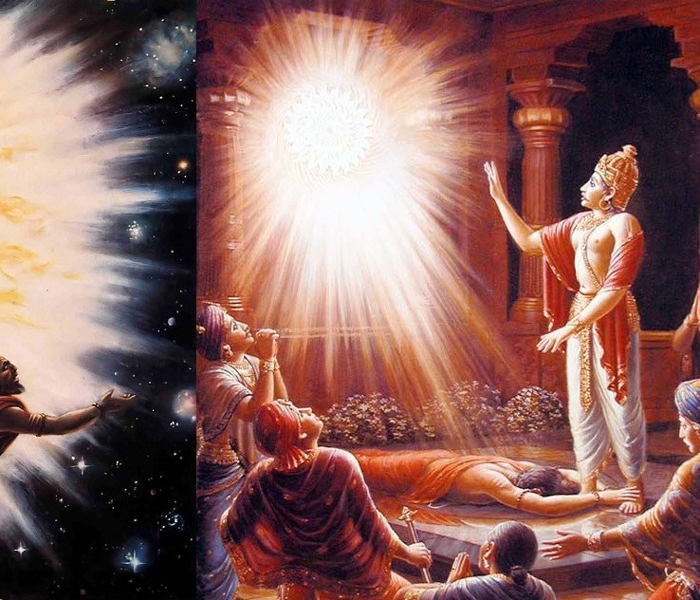
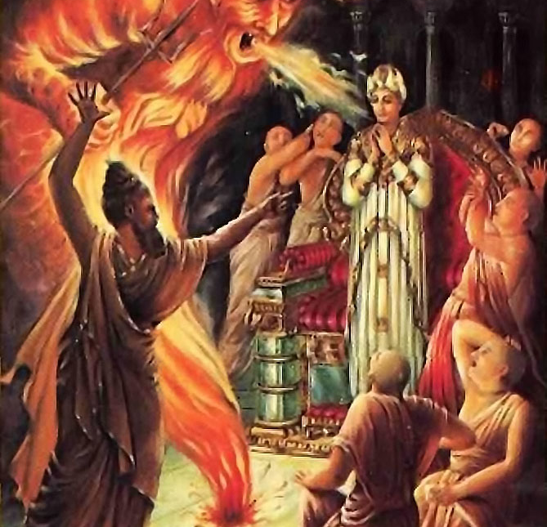
Happiness increases when karma improves
Durvasa muni insulted Ambarish Maharaj
Where there is bhakti, all good qualities reside. [SB 5.18.12]
Do not get dirty by the undue influence of the three modes of material nature. Particularly the mode of ignorance.

Slide 15
कर्म में सुधार होने पर खुशियाँ बढ़ती हैं
दुर्वासा मुनि ने अंबरीश महाराज का अपमान किया
जहां भक्ति होती है, वहां सभी अच्छे गुणों का वास होता है। [SB 5.18.12]
भौतिक प्रकृति के तीन गुन के अनुचित प्रभाव से गंदे न हों। खासतौर पर तमो गुन।

Slide 16
yasyāsti bhaktir bhagavaty akiñcanā sarvair guṇais tatra samāsate surāḥ harāv abhaktasya kuto mahad-guṇā manorathenāsati dhāvato bahiḥ
All the demigods and their exalted qualities, such as religion, knowledge and renunciation, become manifest in the body of one who has developed unalloyed devotion for the Supreme Personality of Godhead, Vāsudeva. On the other hand, a person devoid of devotional service and engaged in material activities has no good qualities. Even if he is adept at the practice of mystic yoga or the honest endeavor of maintaining his family and relatives, he must be driven by his own mental speculations and must engage in the service of the Lord’s external energy. How can there be any good qualities in such a man? [SB 5.18.12]

Slide 17
Synonyms
yasya — of whom; asti — there is; bhaktiḥ — devotional service; bhagavati — to the Supreme Personality of Godhead; akiñcanā — without any motive; sarvaiḥ — with all; guṇaiḥ — good qualities; tatra — there (in that person); samāsate — reside; surāḥ — all the demigods; harau — unto the Supreme Personality of Godhead; abhaktasya — of a person who is not devoted; kutaḥ — where; mahat-guṇāḥ — good qualities; manorathena — by mental speculation; asati — in the temporary material world; dhāvataḥ — who is running; bahiḥ — outside.

Slide 18
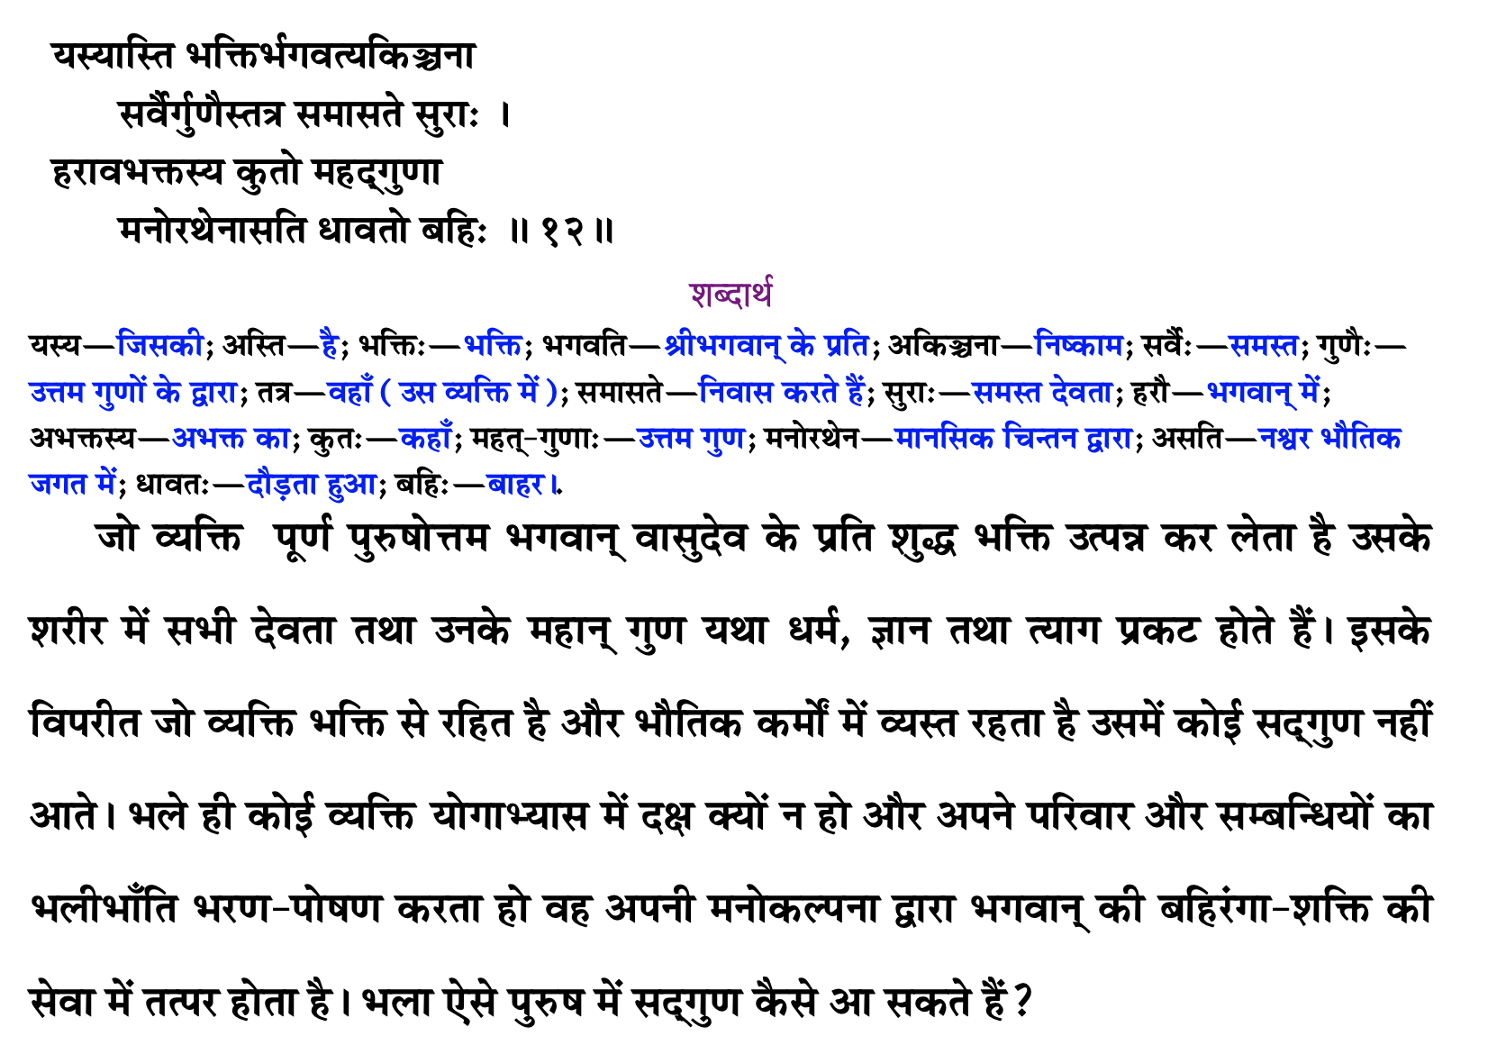

Slide 19
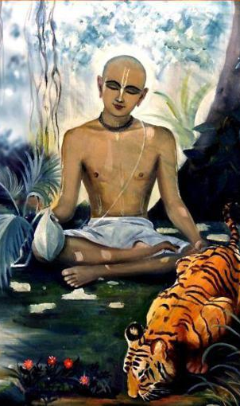
Qualities of Devotee Haridas Thakur
In the Ādi-līlā of Caitanya-caritāmṛta, Chapter Eight, there is a description of some of the qualities of devotees. For example, Śrī Paṇḍita Haridāsa is described as being very well-behaved, tolerant, peaceful, magnanimous and grave. In addition, he spoke very sweetly, his endeavors were very pleasing, he was always patient, he respected everyone, he always worked for everyone’s benefit, his mind was free of duplicity, and he was completely devoid of all malicious activities. These are all originally qualities of Kṛṣṇa, and when one becomes a devotee they automatically become manifest. Śrī Kṛṣṇadāsa Kavirāja, the author of Caitanya-caritāmṛta, says that all good qualities become manifest in the body of a Vaiṣṇava and that only by the presence of these good qualities can one distinguish a Vaiṣṇava from a non-Vaiṣṇava.

Slide 20
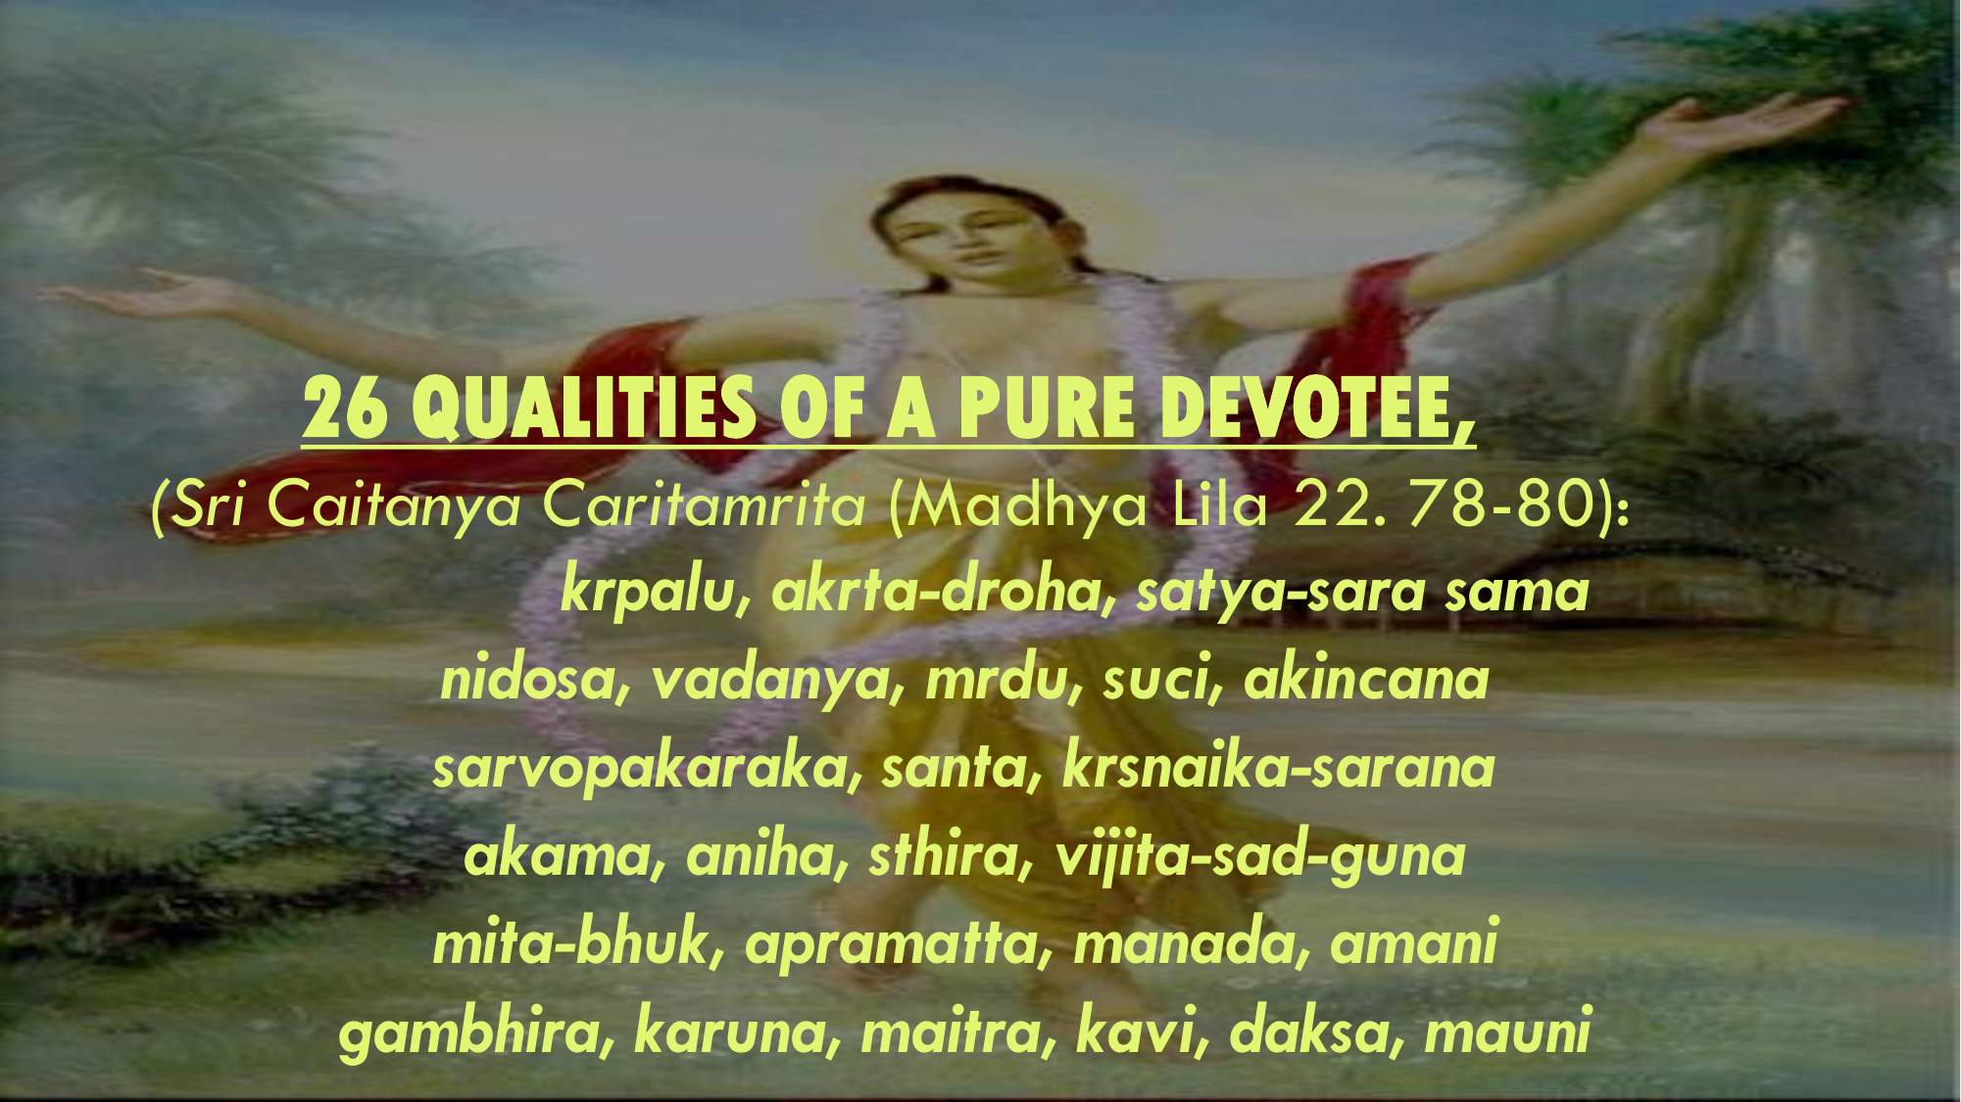
Twenty-six good qualities of a Vaiṣṇava
Kṛṣṇadāsa Kavirāja lists the following twenty-six good qualities of a Vaiṣṇava:
(1) He is very kind to everyone. (2) He does not make anyone his enemy. (3) He is truthful. (4) He is equal to everyone.
(5) No one can find any fault in him. (6) He is magnanimous. (7) He is mild. (8) He is always clean. (9) He is without possessions.
(10) He works for everyone’s benefit. (11) He is very peaceful. (12) He is always surrendered to Kṛṣṇa.
(13) He has no material desires. (14) He is very meek. (15) He is steady. (16) He controls his senses.
(17) He does not eat more than required. (18) He is not influenced by the Lord’s illusory energy. (19) He offers respect to everyone. (20) He does not desire any respect for himself.
(21) He is very grave. (22) He is merciful. (23) He is friendly. (24) He is poetic. (25) He is expert. (26) He is silent.

Slide 21
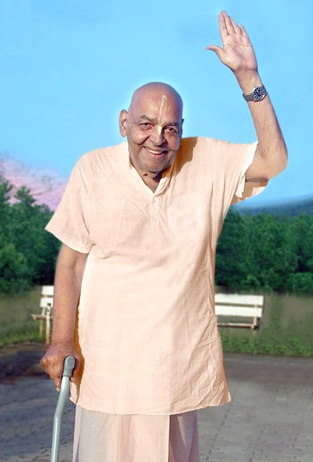
Patience leads to liberation
यं हि न व्यथयन्त्येते पुरुषं पुरुषर्षभ । समदुःखसुखं धीरं सोऽमृतत्वाय कल्पते ॥ १५ ॥
yaṁ hi na vyathayanty ete puruṣaṁ puruṣarṣabha sama-duḥkha-sukhaṁ dhīraṁ so ’mṛtatvāya kalpate
yam — one to whom; hi — certainly; na — never; vyathayanti — are distressing; ete — all these; puruṣam — to a person; puruṣa-ṛṣabha — O best among men; sama — unaltered; duḥkha — in distress; sukham — and happiness; dhīram — patient; saḥ — he; amṛtatvāya — for liberation; kalpate — is considered eligible.
O best among men [Arjuna], the person who is not disturbed by happiness and distress and is steady in both is certainly eligible for liberation.[BG 2.15]

Slide 22
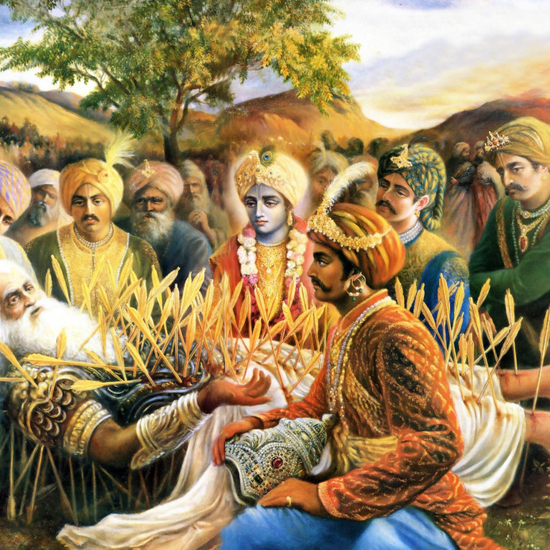
No one knows His plan
न ह्यस्य कर्हिचिद्राजन् पुमान् वेद विधित्सितम् । यद्विजिज्ञासया युक्ता मुह्यन्ति कवयोऽपि हि ॥ १६ ॥
na hy asya karhicid rājan pumān veda vidhitsitam yad vijijñāsayā yuktā muhyanti kavayo ’pi hi
na — never; hi — certainly; asya — His; karhicit — whatsoever; rājan — O King; pumān — anyone; veda — knows; vidhitsitam — plan; yat — which; vijijñāsayā — with exhaustive inquiries; yuktāḥ — being engaged; muhyanti — bewildered; kavayaḥ — great philosophers; api — even; hi — certainly.
O King, no one can know the plan of the Lord [Śrī Kṛṣṇa]. Even though great philosophers inquire exhaustively, they are bewildered.[SB 1.19.16]

Slide 23
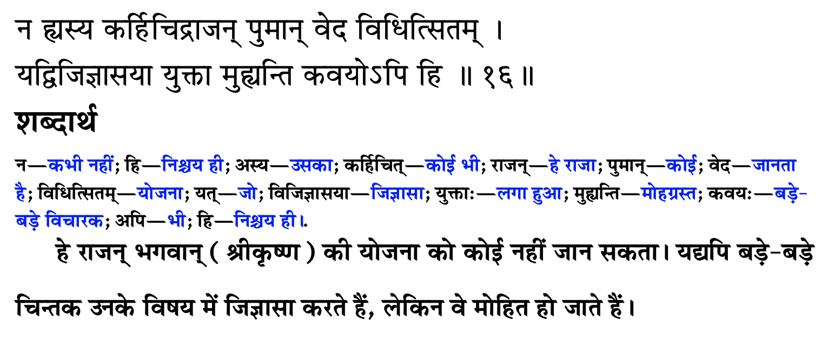
उसकी योजना कोई नहीं जानता

Slide 24
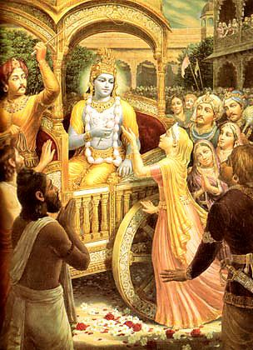
The invisible actor
मायाजवनिकाच्छन्नमज्ञाधोक्षजमव्ययम् । न लक्ष्यसे मूढद‍ृशा नटो नाट्यधरो यथा ॥ १९ ॥
māyā-javanikācchannam ajñādhokṣajam avyayam na lakṣyase mūḍha-dṛśā naṭo nāṭyadharo yathā
māyā — deluding; javanikā — curtain; ācchannam — covered by; ajñā — ignorant; adhokṣajam — beyond the range of material conception (transcendental); avyayam — irreproachable; na — not; lakṣyase — observed; mūḍha-dṛśā — by the foolish observer; naṭaḥ — artist; nāṭya-dharaḥ — dressed as a player; yathā — as.
Being beyond the range of limited sense perception, You are the eternally irreproachable factor covered by the curtain of deluding energy. You are invisible to the foolish observer, exactly as an actor dressed as a player is not recognized.[SB 1.8.19]

Slide 25
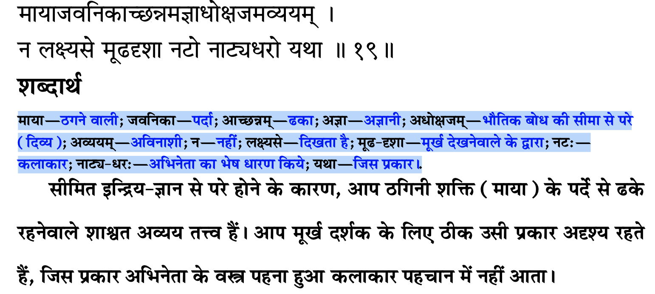
अदृश्य अभिनेता

Slide 26
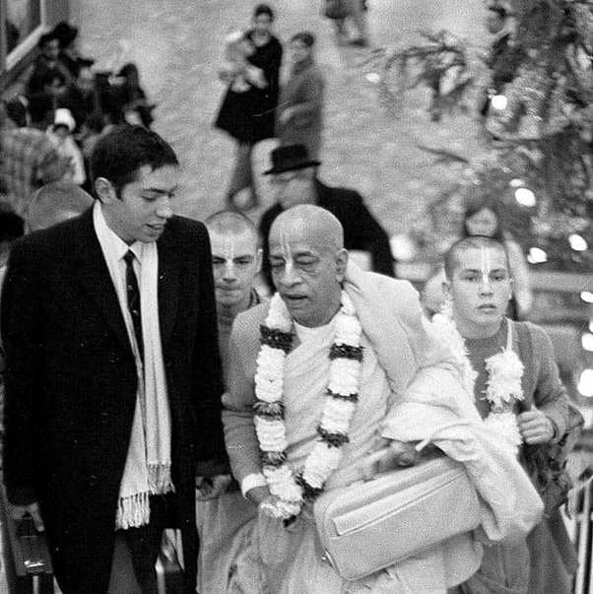
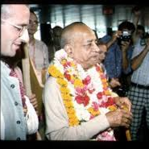
Blame yourself not others – See only Krishna
बहूनां जन्मनामन्ते ज्ञानवान्मां प्रपद्यते । वासुदेव: सर्वमिति स महात्मा सुदुर्लभ: ॥ १९ ॥
bahūnāṁ janmanām ante jñānavān māṁ prapadyate vāsudevaḥ sarvam iti sa mahātmā su-durlabhaḥ
bahūnām — many; janmanām — repeated births and deaths; ante — after; jñāna-vān — one who is in full knowledge; mām — unto Me; prapadyate — surrenders; vāsudevaḥ — the Personality of Godhead, Kṛṣṇa; sarvam — everything; iti — thus; saḥ — that; mahā-ātmā — great soul; su-durlabhaḥ — very rare to see.
After many births and deaths, he who is actually in knowledge surrenders unto Me, knowing Me to be the cause of all causes and all that is. Such a great soul is very rare.[BG 7.19]

Slide 27
Points to remember
Source of all good qualities is ………
Where there is ……… all good qualities reside
Real doer is ……..
Everything happens according to …….. plans.
If we develop habit of seeing ……. in all circumstances, then we will not have …….. towards anybody.
Blame …….. not others

Slide 28
कृपया याद रखें
सभी अच्छे गुणों का स्रोत ……. है
जहां ……. हैं वहां सभी अच्छे गुण निवास करते हैं
असली कर्ता ……. है
सब कुछ ……. की योजना के अनुसार होता है
यदि हम सभी परिस्थितियों में ……. को देखने की आदत विकसित करेंगे तो हम किसी के प्रति …….. नहीं करेंगे.
……. को दोष दें दूसरों को नहीं

Slide 29
Eat sparingly and depend on Krishna
One who eats sparingly, eats away the sorrows.
If something happens to the body, then first thing you do is to shut our mouth.
Firstly, don’t talk much or get angry at anyone.
When you are not the cause, then why are you angry?
Not a leaf can move without His permission.

Slide 30
संयमपूर्वक भोजन करें और कृष्ण पर निर्भर रहें
जो कम खाता है, वे गम खाता है
अगर शरीर शरीर बीमार हो, तो सबसे पहले आप अपना मुंह बंद करें।
सबसे पहले, ज्यादा बात न करें या किसी पर गुस्सा न करें।
जब आप कारण नहीं हैं, तो आप नाराज क्यों हैं?
एक पत्ता भी उनकी अनुमति के बिना नहीं हिल सकता

Slide 31
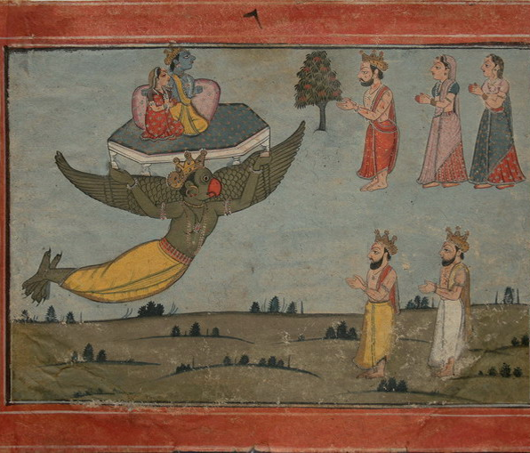
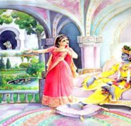
Determination
Any person who observes regulative principles and fulfills his promises by practical activity is called determined.
They must be conscious of the difference between their present conditions and their past conditions and should always be very careful not to fall from the most exalted life of Kṛṣṇa consciousness. Every devotee of Kṛṣṇa should have this determination.
Indra was forcibly deprived of the pārijāta flower

Slide 32
दृढ़ निश्चय
कोई भी व्यक्ति जो नियामक सिद्धांतों का पालन करता है और व्यावहारिक गतिविधियों द्वारा अपने वादों को पूरा करता है, उसे दृढ़ निश्चय कहा जाता है।
उन्हें अपनी वर्तमान स्थितियों और अपनी पिछली स्थितियों के बीच के अंतर के बारे में सचेत रहना चाहिए और हमेशा इस बात का ध्यान रखना चाहिए कि कृष्ण चेतना के सबसे ऊंचे जीवन से न गिरें। कृष्ण के प्रत्येक भक्त का यह दृढ़ संकल्प होना चाहिए।
इंद्र को जबरन पुष्पराज से वंचित किया गया

Slide 33
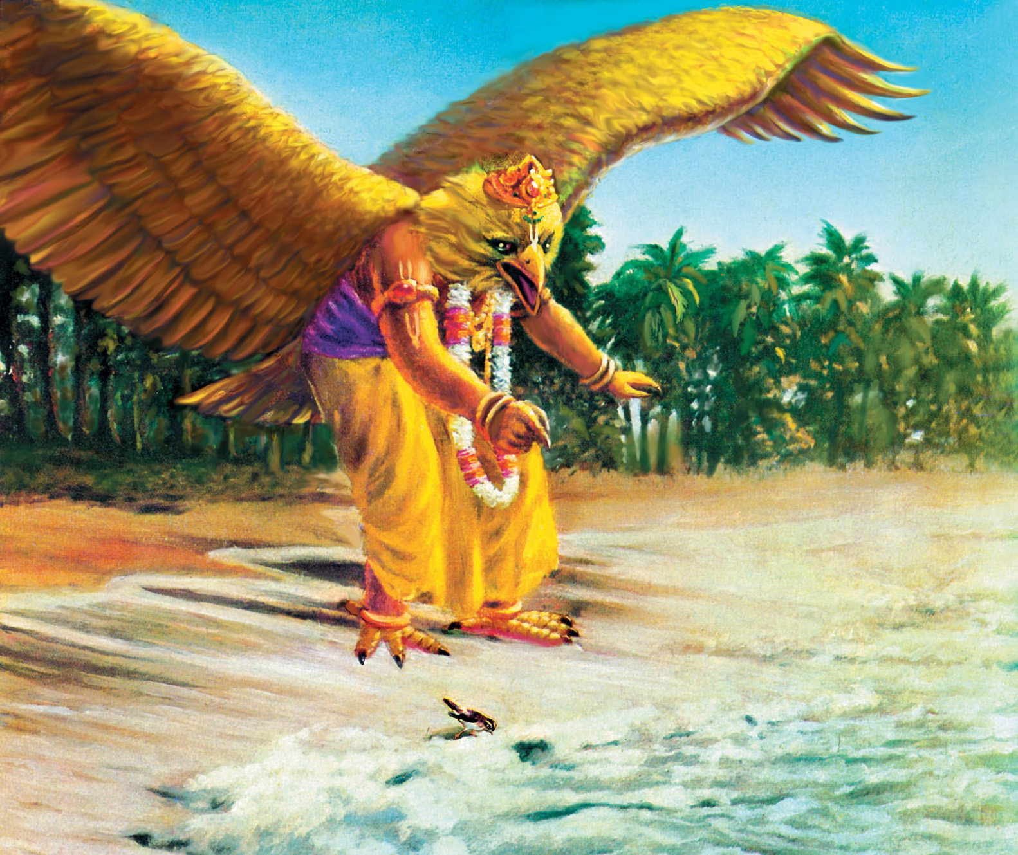

Slide 34
Bg. 18.33
धृत्या यया धारयते मन:प्राणेन्द्रियक्रिया: । योगेनाव्यभिचारिण्या धृति: सा पार्थ सात्त्विकी ॥ ३३ ॥
dhṛtyā yayā dhārayate manaḥ-prāṇendriya-kriyāḥ yogenāvyabhicāriṇyā dhṛtiḥ sā pārtha sāttvikī
Synonyms
dhṛtyā — determination; yayā — by which; dhārayate — one sustains; manaḥ — of the mind; prāṇa — life; indriya — and senses; kriyāḥ — the activities; yogena — by yoga practice; avyabhicāriṇyā — without any break; dhṛtiḥ — determination; sā — that; pārtha — O son of Pṛthā; sāttvikī — in the mode of goodness.
Translation
O son of Pṛthā, that determination which is unbreakable, which is sustained with steadfastness by yoga practice, and which thus controls the activities of the mind, life and senses is determination in the mode of goodness.
Purport
Yoga is a means to understand the Supreme Soul. One who is steadily fixed in the Supreme Soul with determination, concentrating one’s mind, life and sensory activities on the Supreme, engages in Kṛṣṇa consciousness. That sort of determination is in the mode of goodness. The word avyabhicāriṇyā is very significant, for it indicates that persons who are engaged in Kṛṣṇa consciousness are never deviated by any other activity.

Slide 35
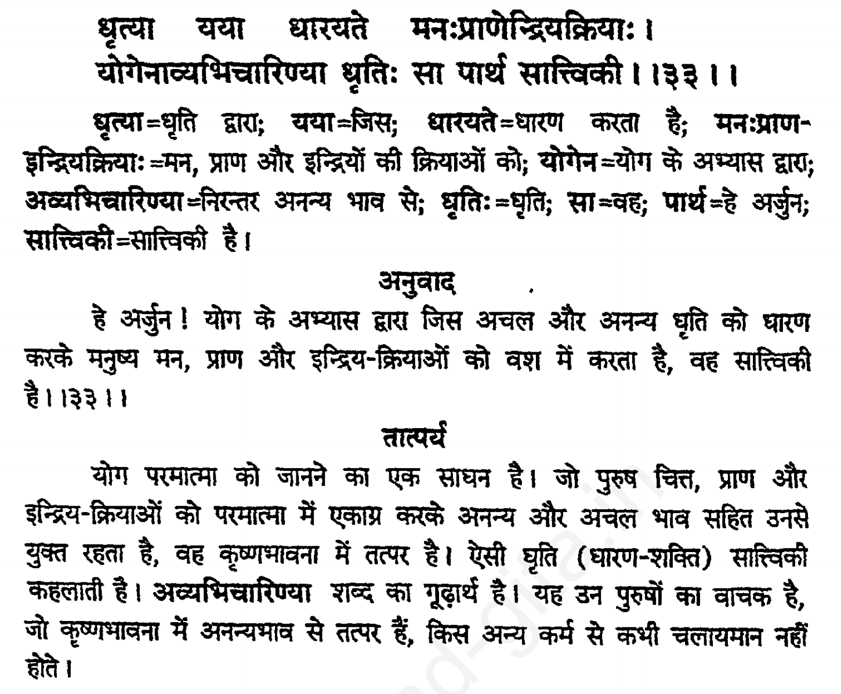

Slide 36
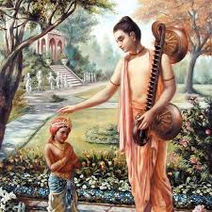
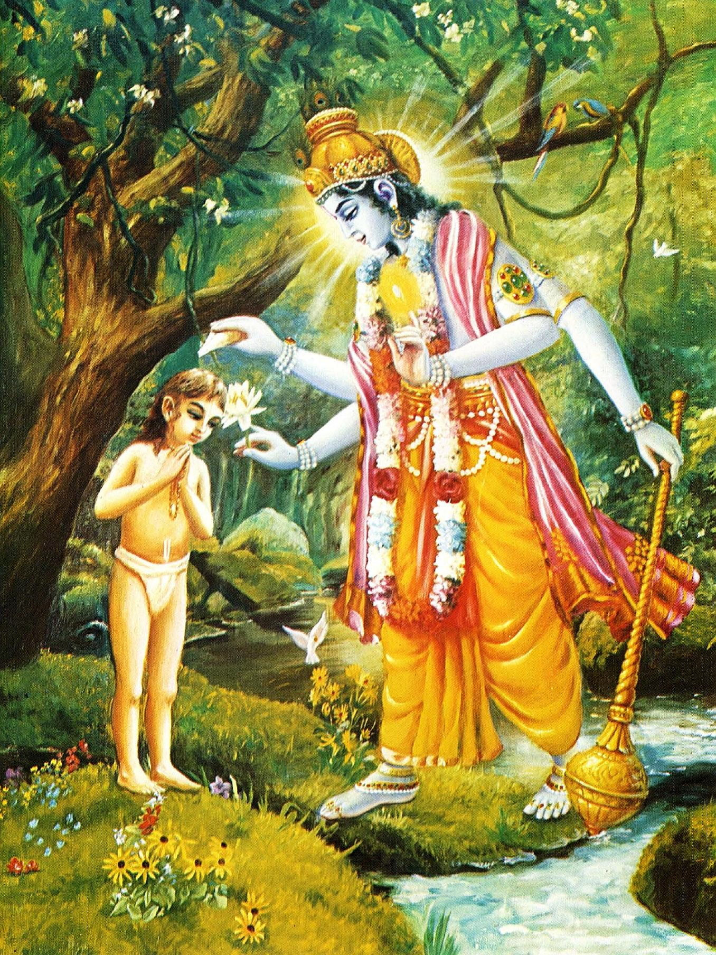
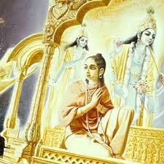
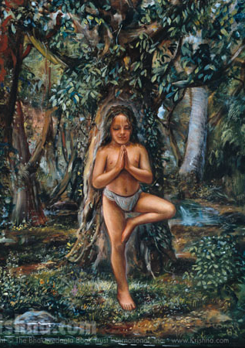
Dhruva Maharaj

Slide 37
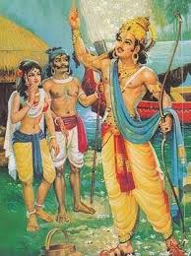
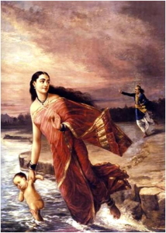
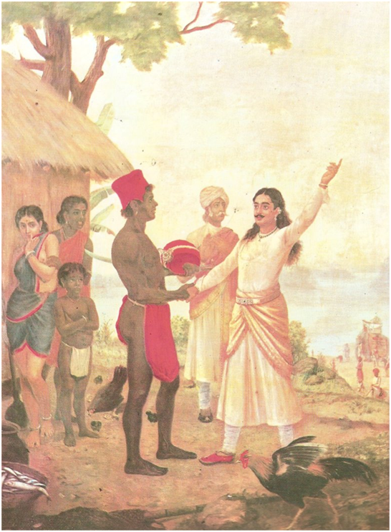
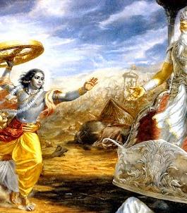
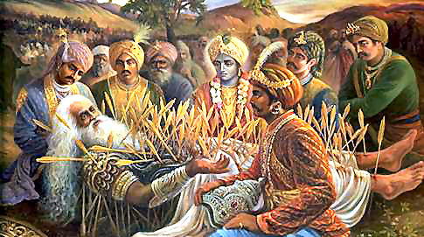
Life of Bhishma Deva

Slide 38
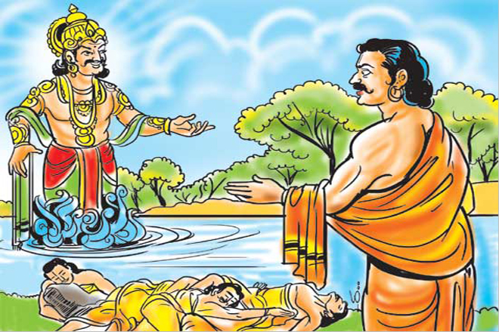
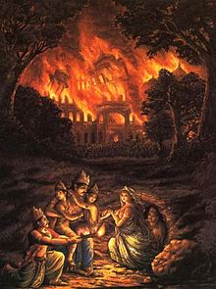
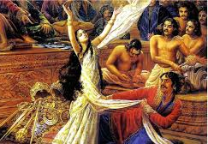
Trials in life of Pandavas
Oh, what terrible sufferings and what terrible injustices you good souls suffer for being the sons of religion personified. You did not deserve to remain alive under those tribulations, yet you were protected by the brāhmaṇas, God and religion.
As far as my daughter-in-law Kuntī is concerned, upon the great General Pāṇḍu’s death, she became a widow with many children, and therefore she suffered greatly. And when you were grown up she suffered a great deal also because of your actions.
In my opinion, this is all due to inevitable time, under whose control everyone in every planet is carried, just as the clouds are carried by the wind. [SB 1.9.12-14]

Slide 39
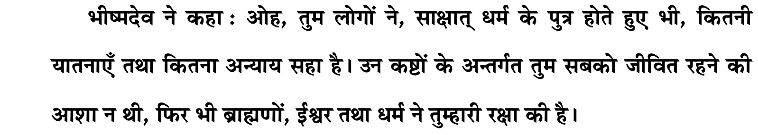
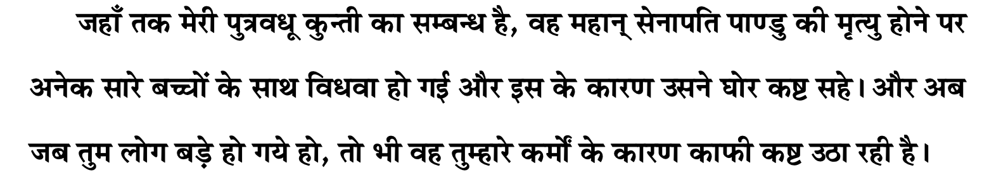
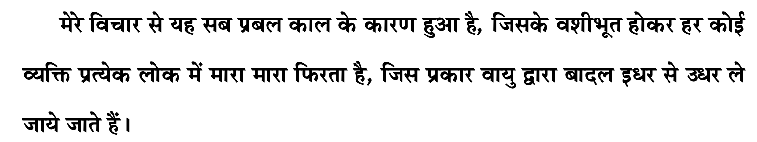
पांडवों के जीवन में परीक्षण

Slide 40
Prayers of Mother Kunti [1.8.18]
kunty uvāca namasye puruṣaṁ tvādyam īśvaraṁ prakṛteḥ param alakṣyaṁ sarva-bhūtānām antar bahir avasthitam
māyā-javanikācchannam ajñādhokṣajam avyayam na lakṣyase mūḍha-dṛśā naṭo nāṭyadharo yathā
tathā paramahaṁsānāṁ munīnām amalātmanām bhakti-yoga-vidhānārthaṁ kathaṁ paśyema hi striyaḥ
kṛṣṇāya vāsudevāya devakī-nandanāya ca nanda-gopa-kumārāya govindāya namo namaḥ
namaḥ paṅkaja-nābhāya namaḥ paṅkaja-māline namaḥ paṅkaja-netrāya namas te paṅkajāṅghraye

Slide 41
Prayers of Mother Kunti
कुन्त्युवाच नमस्ये पुरुषं त्वाद्यमीश्वरं प्रकृते: परम् । अलक्ष्यं सर्वभूतानामन्तर्बहिरवस्थितम् ॥ १८ ॥
मायाजवनिकाच्छन्नमज्ञाधोक्षजमव्ययम् । न लक्ष्यसे मूढद‍ृशा नटो नाट्यधरो यथा ॥ १९ ॥
तथा परमहंसानां मुनीनाममलात्मनाम् । भक्तियोगविधानार्थं कथं पश्येम हि स्त्रिय: ॥ २० ॥
कृष्णाय वासुदेवाय देवकीनन्दनाय च । नन्दगोपकुमाराय गोविन्दाय नमो नम: ॥ २१ ॥
नम: पङ्कजनाभाय नम: पङ्कजमालिने । नम: पङ्कजनेत्राय नमस्ते पङ्कजाङ्‍घ्रये ॥ २२ ॥

Slide 42
Prayer unto lotus feet of Gurudeva
Learn to tolerance and patience
Invest saved time in pages of Bhagavatam
Be reservoir of good qualities
leads to happiness
See the hand of Krishna in everything
free from anger and envy
Be determined
Perform sadhana and be careful of devotional asset
I have to go
be attached to Lord, guru lotus feet and devotees

Slide 43
प्रार्थना - गुरुदेव के चरण कमल
सहनशीलता और धैर्य सीखें
भागवतम के पन्नों में निवेश से बचा हुआ समय
अच्छे गुणों का भंडार हो
खुशियों की ओर ले जाता है
हर चीज में कृष्ण का हाथ देखें
क्रोध और ईर्ष्या से मुक्त
दृढ़ निश्चयी रहें
साधना करें और भक्ति संपत्ति से सावधान रहें
मुझे जाना होगा
भगवान, गुरु के चरण कमल और भक्तों से जुड़े रहें

Slide 44
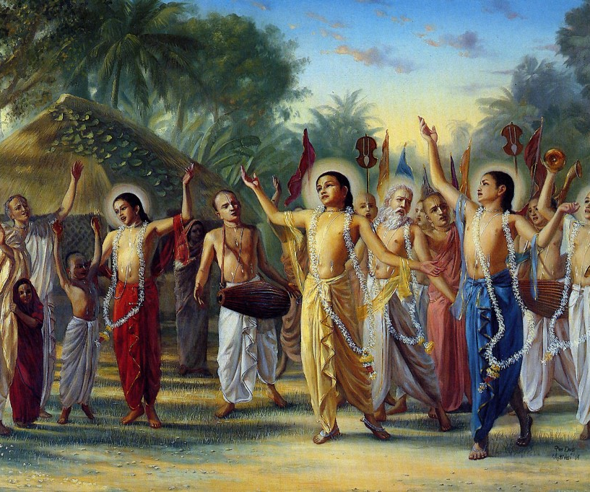
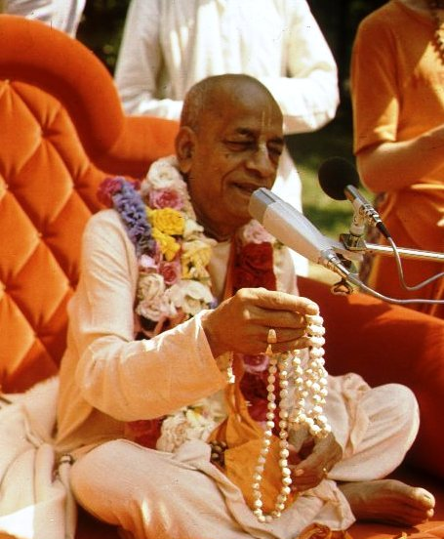
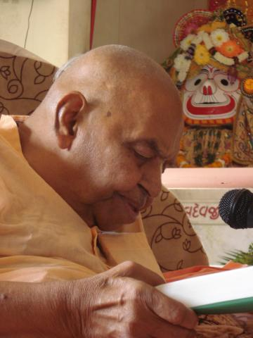
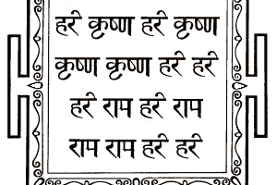
हरे कृष्णा
श्रील प्रभुपाद की जय
गुरुदेव की जय

